Slide 1

Training Load
Soreness
Game Performance
The Confounders
Alex Fan • eric fan • zone li • Anthony wong

Slide 2
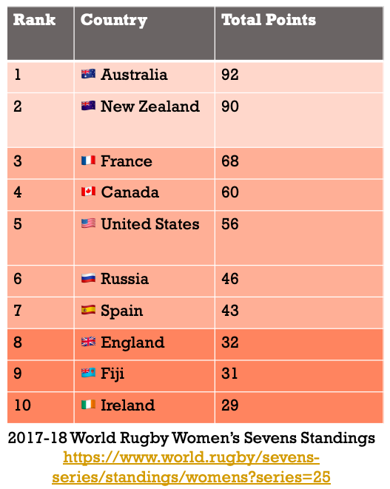
Fatigue
Sleep Quality
Soreness
Irritability
Desire
Exertion

Slide 3
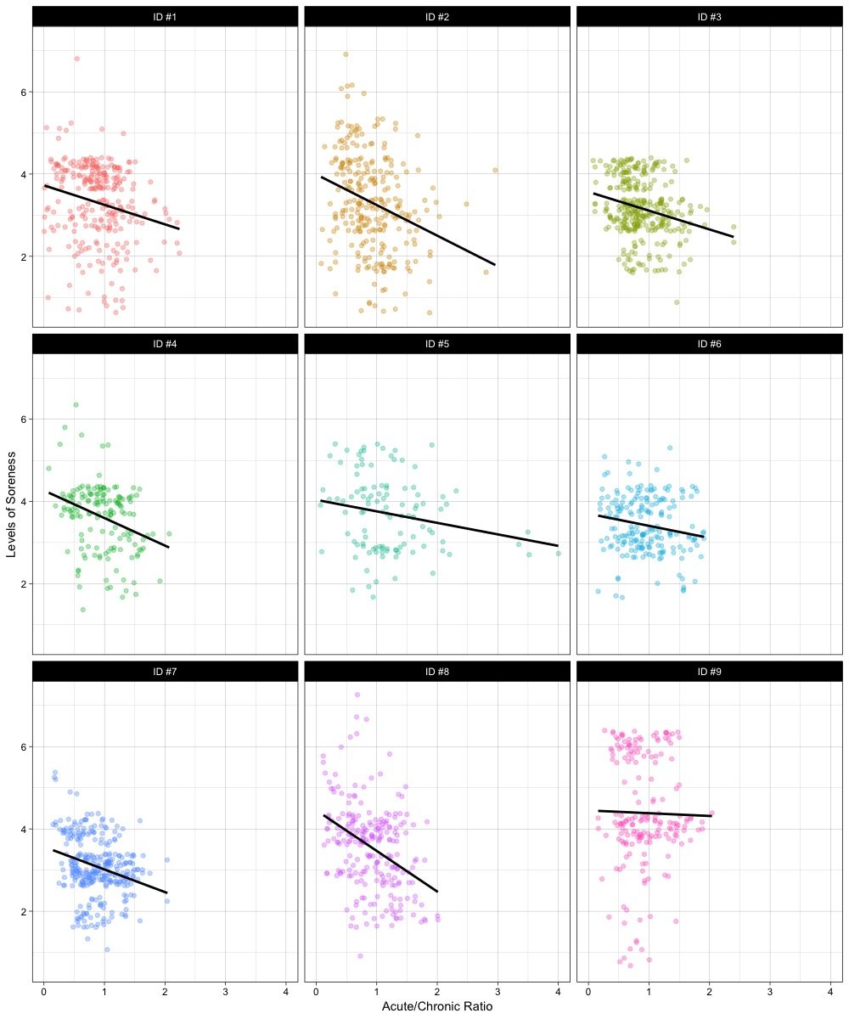
Work Load
Training Structure

